Slide 1


RealState
Website
Software 1 Project
developed by Html,Css
Coding Environment:Visual Code Studio
ID:221-15-4895
ID:221-15-5154

Slide 2

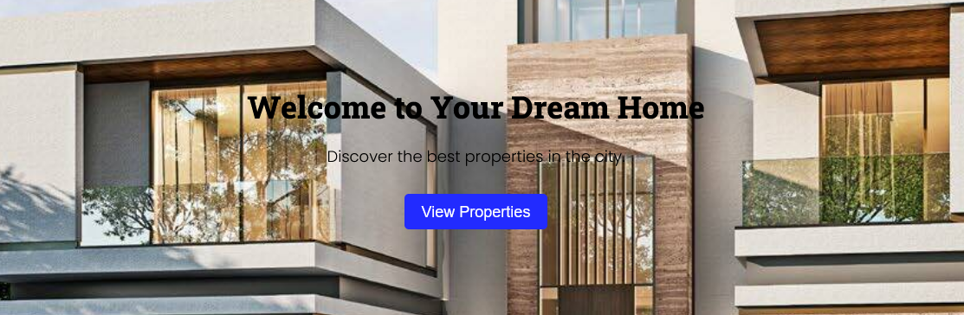
Overview
Explore a world of real estate possibilities on our platform, where buying, selling, and renting converge. Discover your dream home, access seller guides for a smooth selling experience, and navigate home loans with ease. Our comprehensive services create a dynamic marketplace, empowering users at every stage of their real estate journey. Welcome to a one-stop destination for all your property needs.

Slide 3

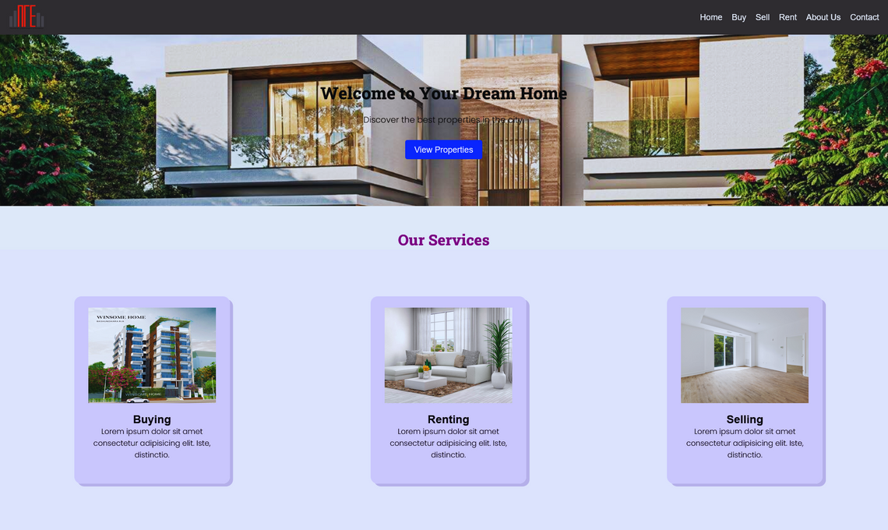
Home Page
Our three main Services:
1.Buying
2.Selling
3.Renting

Slide 4
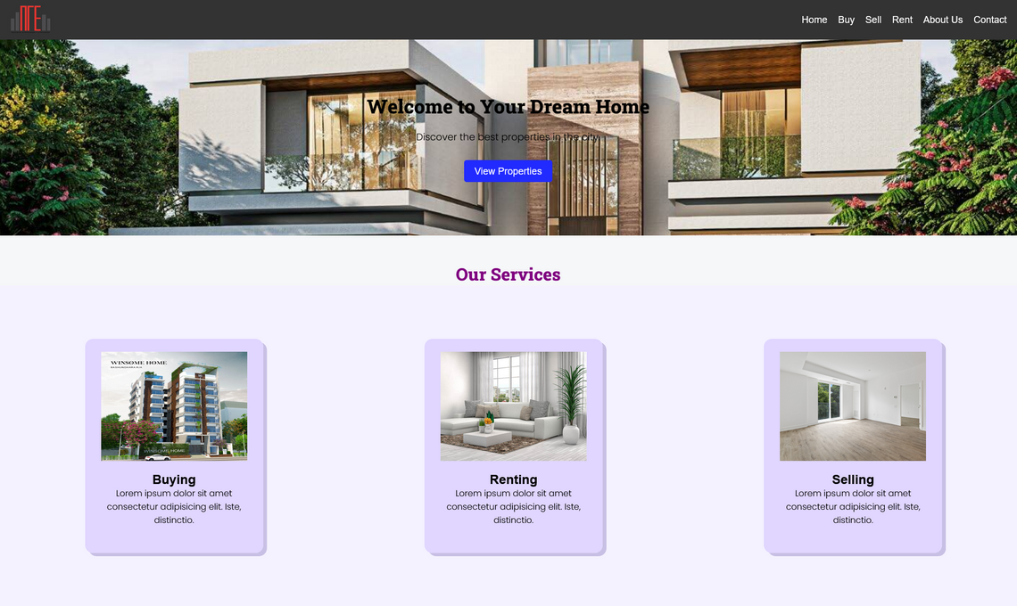
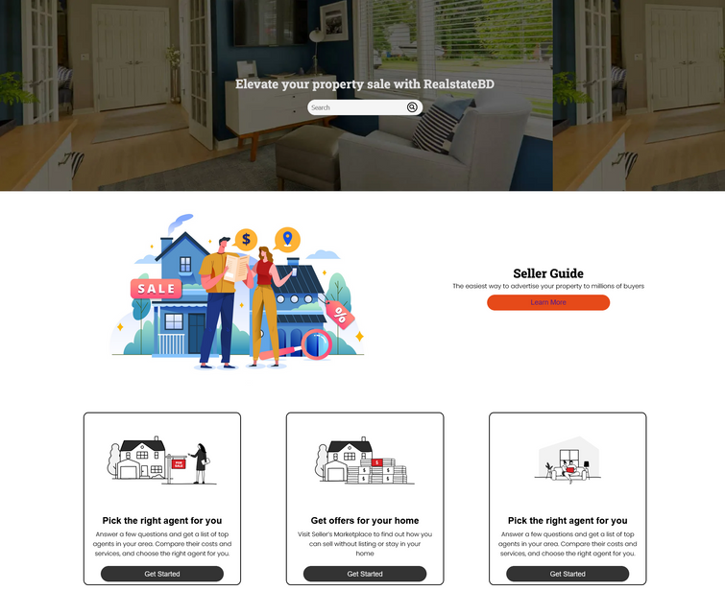
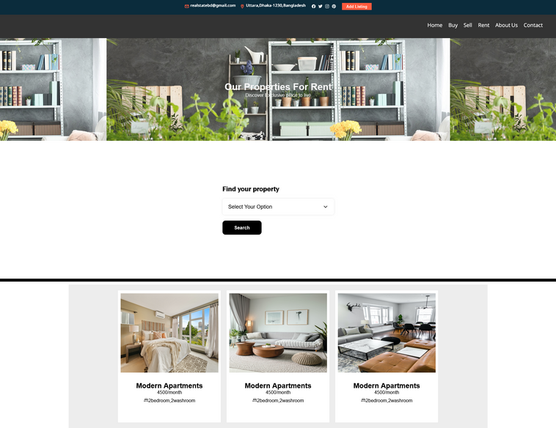
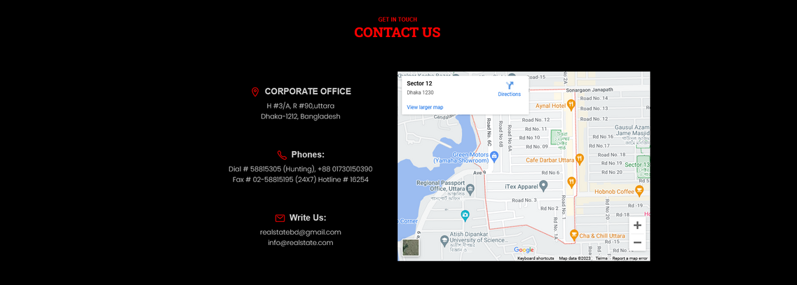
INTRODUCTION
Pages
Home
Sell
Rent
Contact
NEXT

Slide 5
Practical Scenario
Renting
Buying
Selling
Seller Guides
Users looking to rent properties can search for available rental listings, view property details, and contact you for inquiries.
Prospective homebuyers can explore property listings, filter based on preferences, and gather information about the home buying process.
Property sellers can list their properties, showcase features, and connect with potential buyers.
Property sellers can access guides, tips, and resources to navigate the selling process successfully.

Slide 6
THANK YOU FOR YOUR ATTENTION

